Slide 1

UAAPI 2024
NEWS SOURCE REVIEW
-

Slide 2

LEARNING OBJECTIVE
OVERVIEW OF RESEARCH IDEA
Conduct a short research project to answer a question, drawing on several sources and generating additional related, focused questions that allow for multiple avenues of exploration.
Original Idea: News sources and their email list and how they make/display content
Procedure: Signup to the newsletters of all the most popular news companies and then analyze each day the choices in content to include, how they portray headlines, variance in sentiment on issues, and frequency of newsletters or updates.

Slide 3
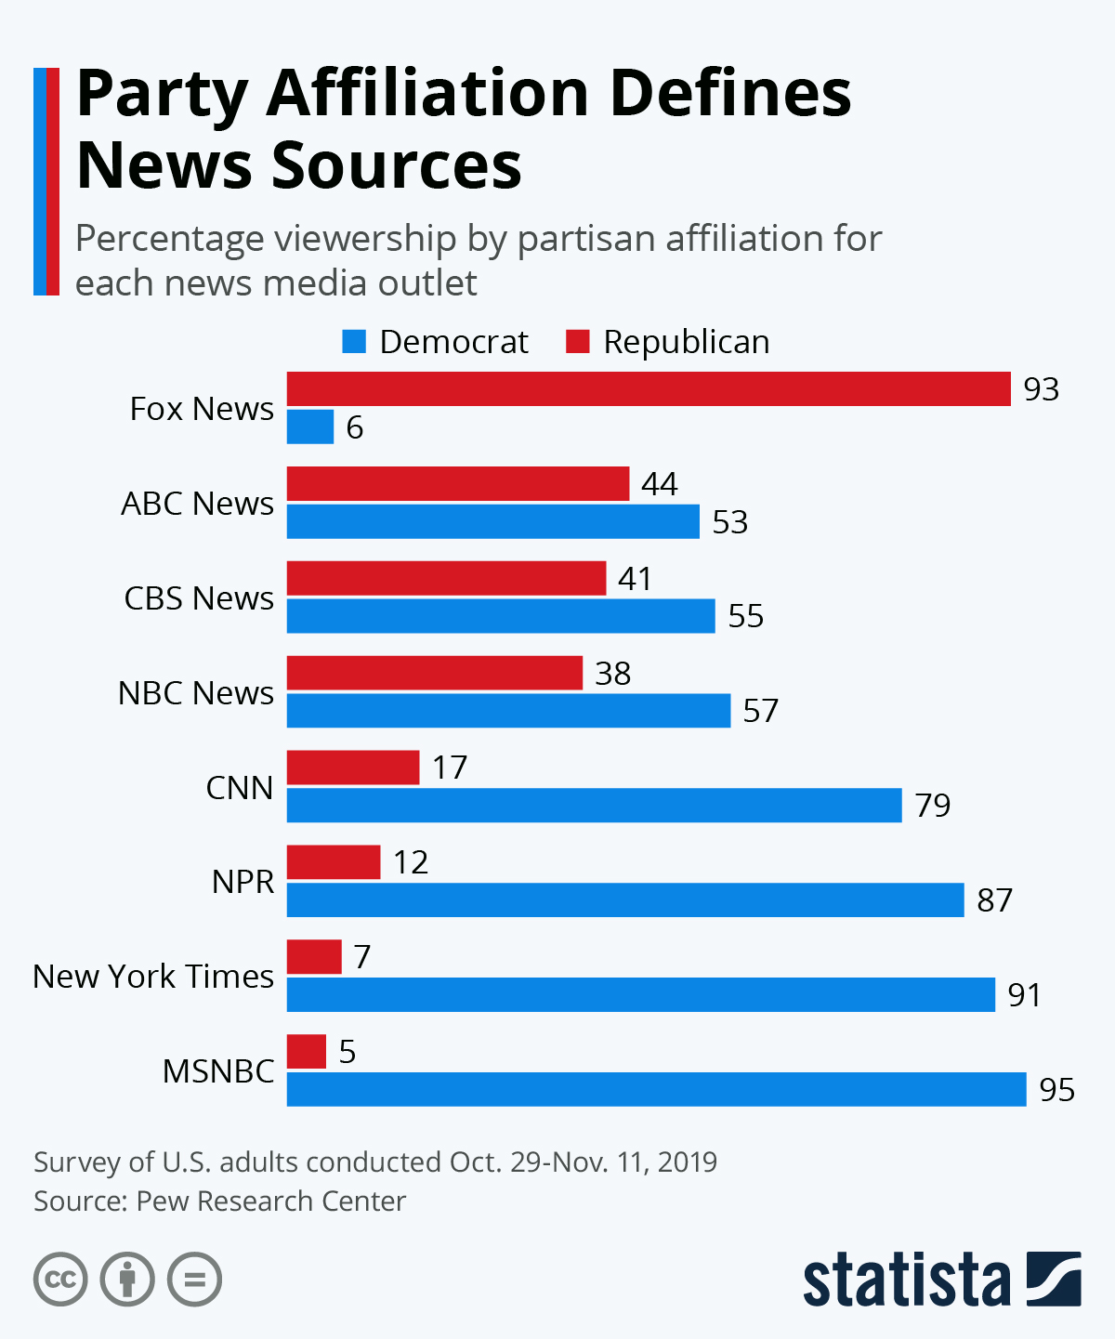
Background
Document: Background of News Source
As we see political division in our country, people also turn to different media outlets based on their party affiliation. Many people trust and distrust different media outlets. Why might we see a stark difference in percentage viewership for different news media outlet based on the partisan affiliation?
Similar study- Email Newsletters: An Analysis of Content From Nine Top News Organizations
This study mentions the implementation of gatekeeping and curation in media outlets. Journalists and publishers sift through large amounts of information and choose what to release to its audiences.
Many news media outlets are also using subscription to provide information or higher quality information to its audiences.

Slide 4
What we want to study
News Source Literature Review.docx
Content choices
Headline Portrayal
Sentiment Variance/Linguistic Bias
Communication Frequency
AI Use
Information Gap/Income Disparity

Slide 5
RESEARCH QUESTIONS & HYPOTHESES
*Docx has list of all hypotheses and research questions.
Document is only a brainstorm of all possible research questions.
Hypotheses & Research Questions (News Source).docx

Slide 6


BROADER IMPLICATIONS
Data collection
Looking into the media outlets privacy policy.
Selling data
Microtargeting
Do the media outlets use personal data to feed specific information to their audience?
Manipulation
Only producing articles that the media want people to believe.
Income Disparity
How different does the "quality" of articles look for the news information available to lower-income households?

Slide 7
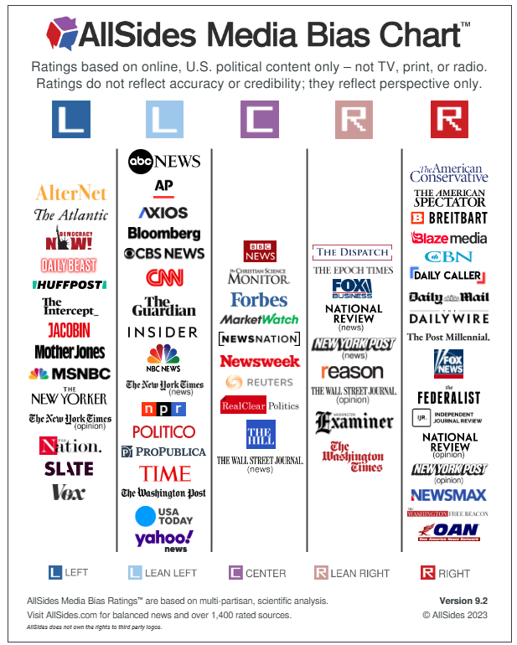
1
Look at the media outlets based on its political bias category.
CHOOSING NEWS SOURCE & NEWSLETTERS
Media Outlet (News Source_Research Setup).xlsx

Slide 8
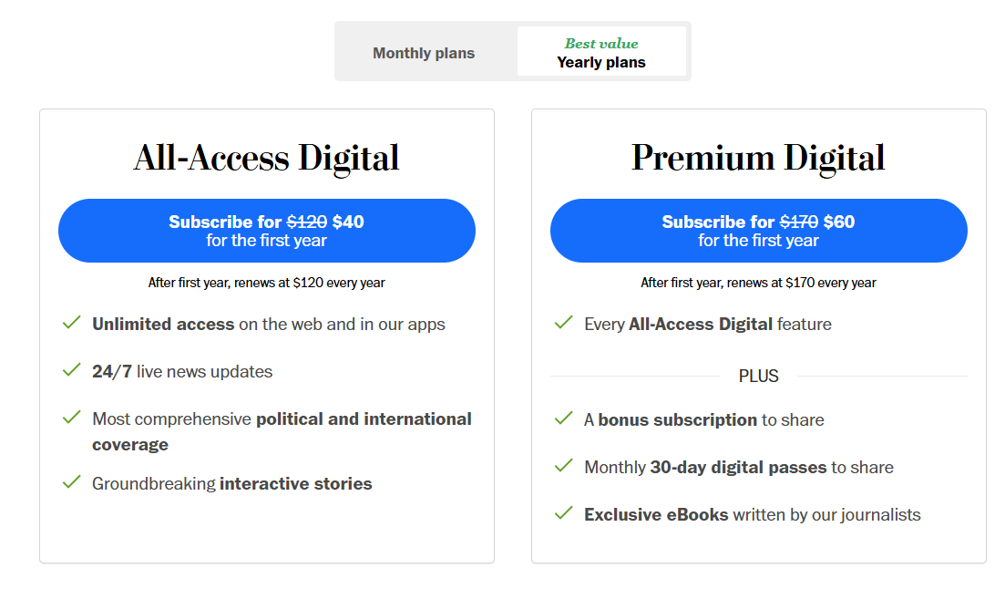
2
Look at the subscription fee cost of the media outlets.
NEWSLETTERS:
Many news media outlets offer their audiences to subscribe to different newsletters.
Top 10 Most Popular US News Topics of 2021:
Coronavirus
Trump
NFL
Capitol
Biden
Impeachment
Vaccine
George Floyd
Football
Police Brutality
The 30 Most Popular US News Topics of 2021 (taboola.com)
3
Ensure that we are studying a variety of media outlets (cable, opinionated, legacy prints).
4
Look at the most popular media outlets used by Americans.

Slide 9

ID FIELDS REQUIRED
Current ID sheet created:News IDSheet.xlsx
Fake ID Attributes
First name, Last Name
*Email
Zip-code
Fake ID
Choosing around 4-5 media outlets from each political bias category (left, lean left, central, lean right, right).
We will have three fake IDs signed up for each media outlets.
60-75 Fake IDs required for the sign up
Each sign up will take around 1 minute = ~1 hour for the sign-up event
*Could possibly have a group of fakeIDs to interact with (by opening emails) to track whether media outlets send emails based on what was interacted with.

Slide 10
HOW TO COLLECT DATA (POST SIGN-UP)
VADER Sentiment Analysis
Interact with the different news organizations with only a group of fake IDs created for interaction purposes.
Interacting may look like opening linked articles in the newsletters to see if news organizations will then only send articles similar to the ones clicked.
AI Checker
Can we extract the most repeated words (similar to creating a word cloud) in each newsletter and compare them side by side?
Analyze the style of headlines written
Would require creating 2-4 styles of headlines that may be written by journalists (question,
How frequently are they sending emails with subscription plans?
* It would be difficult to analyze the articles itself because of paywalls implemented in some organizations.

